Slide 1
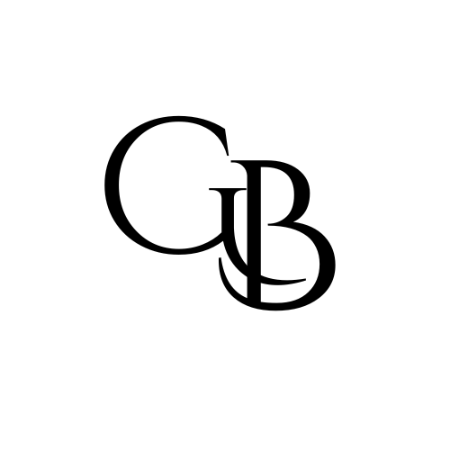
G&B INDUSTRY RESEARCH | SERVICE INFRASTRUCTURE
Dimensional Metrology & Gauge Calibration | Sep 2026
Assessment: 1.73 / 3.0 (58%) | Pending analyst review | Screen incomplete
Industry Overview
Independent labs calibrate and repair dimensional gauges for precision manufacturers. Five providers reviewed: three family-owned claims and two acquired comps. Exact U.S. service TAM and scaled independent target pool remain unknown.
Industry Thesis
Production quality depends on trusted measurements. Specialist labs can retain repeat equipment-service relationships through dependable calibration, repair and records, without making instruments or owning customer factories.
Macro Trends & Growth Drivers | Risks & Concerns
Trust, Compliance & Verification Precision and audit requirements create scheduling, certificate and traceability work. Transcat FY2025 service growth: 7% (broader-company proxy). Exact niche growth above GDP is unverified. | INITIAL SCREEN INCOMPLETE Typical EBITDA and $500M+ niche TAM unverified. Strong consolidator activity. Technical-manager retention, quality liability and reference-equipment investment matter.
Economics & Pricing | Competitive Landscape
Per-instrument/batch fees, repair and scheduled service. Repeat demand supported; contracted share and retention unknown. Transcat FY2025 service gross margin: 33.4%, NOT niche EBITDA. No universal NIST annual calibration rule; intervals depend on use and requirements. | Potential independents: Northeast Metrology (MA), Americal (MA), United Standards Lab (MN); ownership claims and scale require diligence. Cal-Tec and MicronPA are MTA-owned comps, excluded from supply. Transcat, Trescal and MTA demonstrate consolidation.
Customers | Barriers to Entry
Precision manufacturers and quality departments; labs with dimensional measuring assets. Service-heavy scope excludes electrical power testing and product-testing labs. | Technical competence, accreditation scope, traceability and reliable turnaround. Switching is possible; no measured retention or pricing moat established.
Key Success Factors
Retain quality leadership; verify accreditation scope and equipment standards; schedule repeat work and measure turnaround. Separate service earnings from resale. | J-curve cushion (inference): repeat measurement needs and trusted records. G&B fit: Medium/Weak; no warm owner route or committed operator. No outreach yet.
Exit
Strategic and sponsor-backed laboratory buyers are visible; no exit multiple assumed. Next proof: typical EBITDA, exact niche TAM/growth, ownership/scale and a credible technical operator. Sources follow.
Strictly Confidential
Notes:
33% of people have set up

Slide 2
Sources | Dimensional Metrology
1 of 4
I1 — Sequential synthesis and expansion
Gathering posts and sequential synthesis context for the calibration-service hypothesis.
Open source
I2 — Live Industry Research Tracker
Fresh four-tab duplicate/lifecycle check; neither proposed niche appears; killed generic BPO remains excluded.
Open source
C1 — Northeast Metrology owner and operating history
Owner Mark Kuehl, took over from father in 2008; hundreds of yearly customers, thousands of certificates; manufacturing measurement repair/calibration; East Longmeadow MA.
Open source
C2 — Americal calibration services
Self-described family-owned since 1997; mechanical/dimensional scope, service lab and on-site work, records portal; Danvers MA.
Open source
C3 — United Standards Lab services
Dimensional/mechanical accredited calibration; service-only model; Bloomington MN.
Open source

Slide 3
Sources | Dimensional Metrology
2 of 4
C4 — United Standards Lab ownership
Family-owned operation established 1965; A 2LA accreditation claim.
Open source
C5 — MTA acquires Cal-Tec; MicronPA already acquired
Acquirer primary announcement identifies Cal-Tec and earlier MicronPA acquisitions. These are comps, not independent targets despite stale provider ownership copy.
Open source
C6 — Transcat FY2025 SEC annual report
Broad service segment FY 2025 revenue $181.428M, 7.0% growth, 33.4% gross margin. NOT standalone dimensional industry EBITDA or market CAGR.
Open source
C7 — Transcat FY2026 annual report
FY 2026 consolidated revenue$331.9M and adjusted EBITDA$48.7M; service revenue+20% includes acquisition effects; recurrent calibration demand. Company comp only, not industry margin.
Open source
C8 — NIST recommended calibration interval
No universal NIST recalibration interval; cadence depends on instrument stability, use, accuracy, contracts and applicable requirements.
Open source

Slide 4
Sources | Dimensional Metrology
3 of 4
C9 — A2LA calibration program
Accreditation assesses technical calibration competence; supports manufacturer/lab measurement confidence.
Open source
C10 — A2LA accredited organization directory
Live searchable taxonomy/density route; no filtered independent US dimensional-firm count produced.
Open source
C11 — Trescal acquisition announcements
January 2026 release lists 14 global acquisitions; clear consolidator activity, not 14 US dimensional firms.
Open source
C12 — Calder September 9 metrology teaser
Anonymous dimensional/metrology provider embedded in distributor; seller cashflow not treated as EBITDA/industry margin.
Open source
C13 — MicronPA service description
York PA dimensional/gage services, stale privately-owned copy superseded by acquirer announcement.
Open source

Slide 5
Sources | Dimensional Metrology
4 of 4
C14 — Cal-Tec provider description
Pittsburgh PA dimensional/electronic/process services, family-owned copy superseded by MTA announcement.
Open source
Scoring: provisional evidence-weighted industry assessment. Missing facts penalized, not asserted adverse facts. Full methodology and criteria in companion scorecard.

